Slide 1
Chapter Two: Sensation and Perception
Meanings of Sensation and perception
Sensory thresholds and sensory adaption
Perception
Selectivity of perception: Attention
Form perception
Depth perception
Perceptual Constancies
Perceptual Illusion

Slide 2
2.1 Meanings of Sensation and Perception
What do these statements suggest to you?
“I heard but I didn’t listen”
“I touched but I didn’t grasp”
Sensation is the process through which sense organs detects stimulus from the environment and the receptor cells in the sense organs recode the physical energy or stimulations in to a neural message a phenomenon called transduction and sends the nerve impulses to the brain.
Perception is the process that organizes sensations into meaningful patterns. It is the process whereby the brain interprets sensations, giving them order and meaning.
Thus, hearing sounds and seeing colors is largely a sensory process, but forming a melody and detecting patterns and shapes is largely a perceptual process.

Slide 3
2.2 The Sensory Laws
Sensory threshold and sensory adaptation are the two general laws of sensation, that explain how sensation works.
How much intense must a stimulus be for you to detect it?
Sensory threshold is the minimum point of intensity a sound can be detected. There are two laws of sensory threshold: The law of absolute threshold and the law of difference threshold.
Absolute threshold (Limen) is the minimum level of stimulation that can be detected. E.g., a cup of coffee require a certain amount of sugar before you could detect a sweet taste.
In addition to the intensity of the stimulus, absolute threshold is also affected by physical and psychological factors of the individual such as response-bias.
Thus, psychologists define absolute threshold as the minimum level of stimulation that can be detected 50 % of the time when a stimulus is presented again and again.

Slide 4
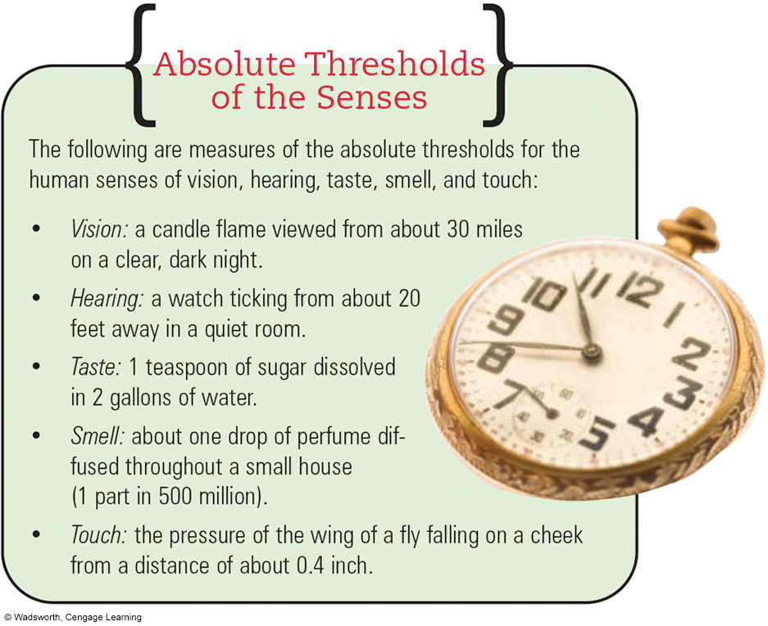

Slide 5
Difference threshold
Difference threshold or just noticeable difference (JND) is the minimum amount of change in the intensity/amount of a stimulus needed for us to recognize that a change has occurred. E.g., a cup of coffee require a certain additional amount of sugar in a cup of coffee to detect an increase in its sweetness.
Like in absolute threshold, the difference threshold for a particular sensory experience varies from person to person and from occasion to occasion.
Thus, psychologists formally define the difference threshold as the minimum change in stimulation that can be detected 50 percent of the time by a given person.

Slide 6
Sensory Adaptation
Your senses are constantly bombarded by stimulation, but why do you notice only certain stimuli?
Sensory adaptation is a tendency of our sensory receptors to have decreasing responsiveness to unchanging stimulus.
Sensory adaptation lets you detect potentially important change in your environment while ignoring unchanging aspects of it. For example, people living in “Kera”/Addis Ababa stopped noticing the bad smell of that environment.
We may not adapt extremely intense sensations
Adapting harmful stimuli might be harmful or even fatal

Slide 7
2.3.Perception
Perception is a meaning making process
The major characteristics of the perceptual process includes;
Selectivity of perception (attention),
Form perception,
Depth perception,
Perceptual constancy, and
Perceptual illusion.
1. Selectivity of perception (Attention): refers to the perceptual process that selects certain inputs for inclusion in your conscious experience, or awareness, at any given time, ignoring others.

Slide 8
…
The selectivity of perception implies, that our field of experience is divided into what is known as - Focus & - Margin.
Events or stimuli that you perceive clearly are the focus of your experience and other items or stimuli that you perceive dimly or vaguely are in the margin of your attention.
Attention shifts constantly. What is in the focus of your attention one moment may be in margin; and what is in the margin may become in your focus.
What factors do you think determine your attention?

Slide 9
Paying attention is in general a function of two factors: factors external to the perceiver and factors internal to the perceiver.
External factors refer to factors that are generally found in the objects or stimuli to be perceived.
Some of the external characteristics of objects that determine whether you are going to attend them or not are size and intensity, repetition, novelty (or newness), and movement.
In general, stimuli in the environment that, are bigger and brighter, more frequently occurring, or newer or moving are likely to get your attention.

Slide 10
Paying attention is not determined only by the characteristics of objects.
Even when a stimulus is bigger, brighter, new frequent, or moving, you may not give it attention if you are not psychologically ready to attend to it. Hence, attention giving also depends on your psychological states as an observer.
Psychologists have identified two important psychological factors:
Set or expectancy and
Motives or needs.

Slide 11
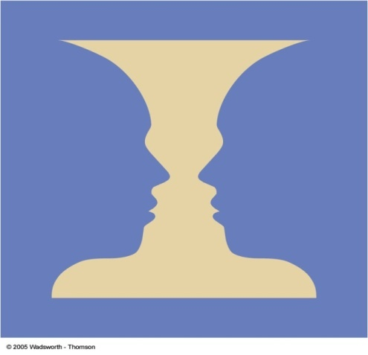
2. Form perception
Visual sensations, provide the raw materials that are to be organized into meaningful patterns, shapes, forms, and concepts or ideas or form perception.
The meaningful shapes or patterns or ideas that are made perhaps out of meaningless and discrete or pieces and bites of sensations refer to form perception.
To perceive forms (meaningful shapes or patterns), you need to distinguish a figure (an object) from its ground (or its surrounding).

Slide 12
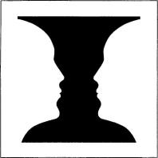
What helps us to separate the figure from the ground in our visual perception?
Contours in Form Perception You are able to separate forms from the general ground only because you can perceive contours. Contours are formed whenever a marked difference occurs in the brightness or color
of the background.
II. Organization in Form Perception When several objects are present in the visual field, we tend to perceive them as organized into patterns or groupings. As Gestalt psychologist said - the whole is more than the sum of its parts.
Organization in perception partially explains our perception of complex patterns as unitary forms, or objects.
How do we organize sensory data in form Perception?

Slide 13

Some laws of perceptual organization?
I. Law of Proximity: The laws of proximity says that items which are close together in space or time tend to be perceived as belonging together or forming an organized group.

Slide 14

II. Law of similarity
According to the law of similarity, similar items tend to be organized together. E.g., three dots in a ring/ circle is seen as a triangle. However, grouping according to similarity, does not always occur. Similarity is competing with the organizing principle of symmetry, or good figure.

Slide 15
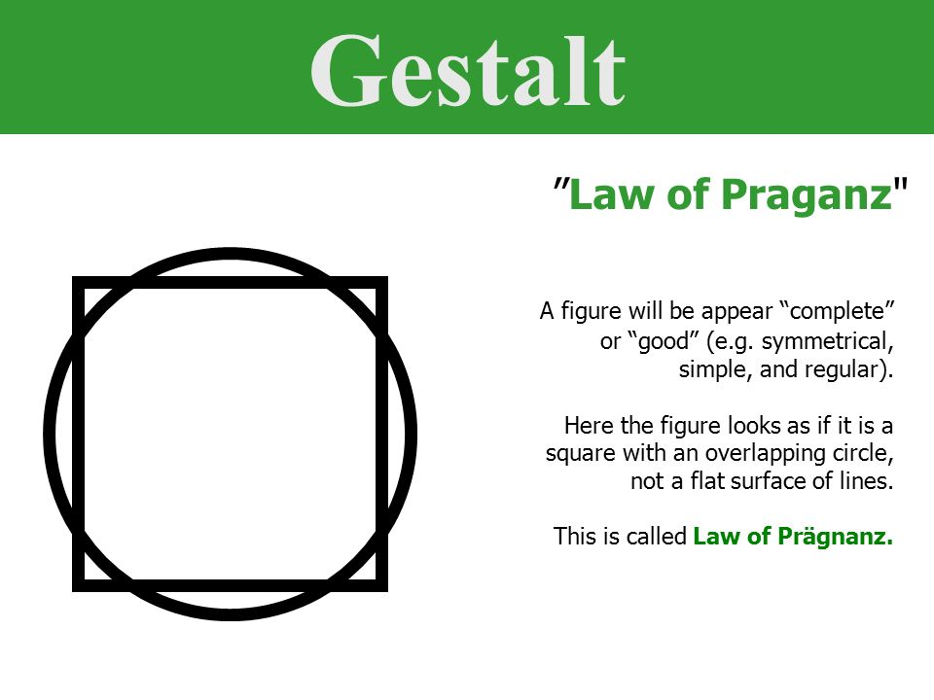

III. The law of good figure:
It is a tendency to organize things to make a balanced or symmetrical figure that includes all the parts. E.g., six dots in a circle may be seen as a hexagon, star or another symmetrical figure.

Slide 16
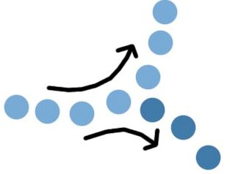
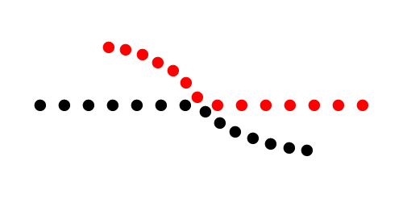
IV. Law of Continuity
It is the tendency to perceive a line that starts in one way as continuing in the same way. E.g., a line that starts out as a curve is seen as continuing on smoothly curved course.

Slide 17


V. Law of closure
The law of closure refers to perceptual processes that organize the perceived world as complete by filling in gaps in stimulation.

Slide 18

VI. Law of Common Fate
It is the tendency to group objects as part of the same group, that move together, or seem to move together, and in the same direction. E.g., we often see flocks of birds or herds of cattle, or boys or girls playing together as one group.

Slide 19
3. Depth Perception
While form perception is our understanding of the world from two-dimensions (height & width), depth perception is our judgment of the world from the third dimension (distance or depth of objects)
Depth perception depends on the use binocular cues (require two eyes) & monocular cues (require one eye).
There are two kinds of binocular cues: retinal disparity and convergence. The two kinds of binocular cues require the interaction of both eyes.
Retinal disparity is, the degree of difference between the image of an object that are focused on the two retinas. The closer the object, the greater is the retinal disparity.
Convergence is the degree to which the eyes turn inward to focus on an object. The closer the objects are the greater the convergence of the eyes.

Slide 20
Monocular cues
People who have lost sight in one eye may still have good depth perception with monocular cues, mentioned below.
Accommodation - change in the shape of the lens that lets you focus the image of an object on the retina. The closer the object the greater the accommodation of the lens but, prolonged accommodation can alter your depth perception.
Motion parallax - the tendency to perceive ourselves as passing objects faster when objects are closer to us than when they are farther away.
C. Pictorial cues – are cues which artists use them to create depth in their drawings and paintings.
Pictorial cues include Interposition, Relative size, Linear perspective, Elevation, Shading patterns, Aerial perspective, and Texture gradient

Slide 21
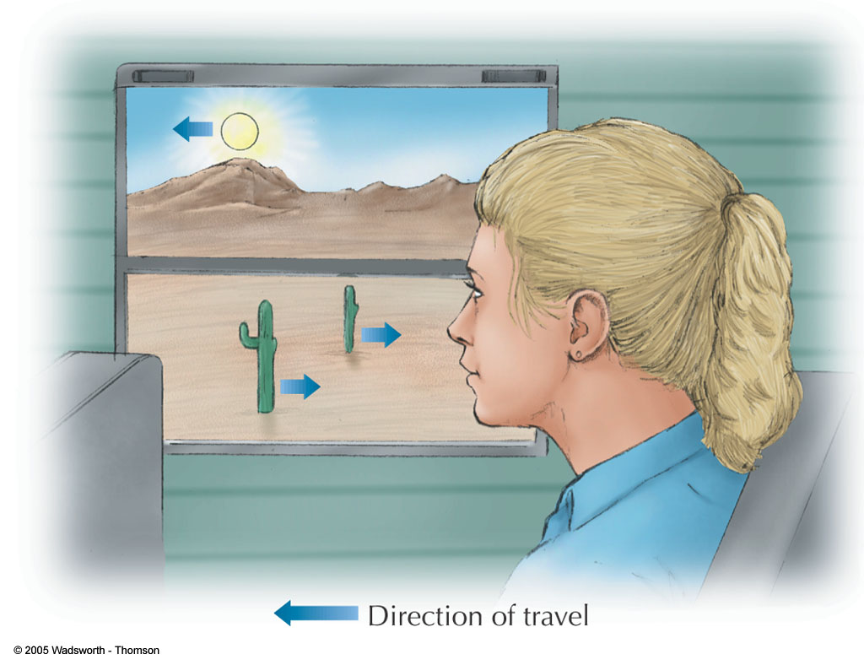
.
FIGURE 4.41 The apparent motion of objects viewed during travel depends on their distance from the observer. Apparent motion can also be influenced by an observer’s point of fixation. At middle distances, objects closer than the point of fixation appear to move backward; those beyond the point of fixation appear to move forward. Objects at great distances, such as the sun or moon, always appear to move forward.

Slide 22
Pictorial cues …
A. Interposition: object that overlaps another object appears closer.
B. Relative size: if two people have the same height and one casts a smaller image on your retina, you will perceive that person as farther away.
C. Linear perspective: parallel objects seem to get closer as they further away.
D. Elevation - Objects that are higher in your visual field seem to be farther away. If you paint a picture, you create depth by placing more distant objects higher on the Canvas.
E. Shading patterns: areas that are in shadow tend to recede, while areas that are in light tend to stand out.
F. Aerial perspective (clarity of objects): Closer objects seem clearer than more distant ones.
G. Texture gradient: the nearer an object, the more details we can make out & the farther an object, the fewer details we can make out.

Slide 23
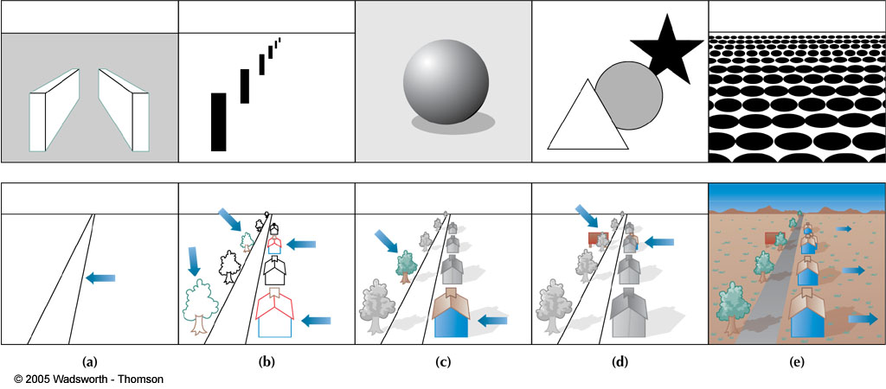
FIGURE4.38 (a) Linear perspective. (b) Relative size. (c) Light and shadow. (d) Overlap. (e) Texture gradients. Drawings in the top row show fairly “pure” examples of each of the pictorial depth cues. In the bottom row, the pictorial depth cues are used to assemble a more realistic scene.

Slide 24
4. Perceptual Constancies
The image of a given object focused on your retina may vary in size, shape, and brightness. Yet we continue to perceive the object as stable in size, shape, and brightness because of perceptual constancy.
This adaptive process of perceiving the world as stable object includes;
Size constancy - makes you interpret a change in its retinal size as a change in its distance rather than in its size.
Shape constancy - assures that an object of known shape will appear to maintain its normal shape regardless of the angle from which you view it.
Brightness constancy - we perceive the object as having a constant brightness though the amount of light reflected from a given object can vary.

Slide 25
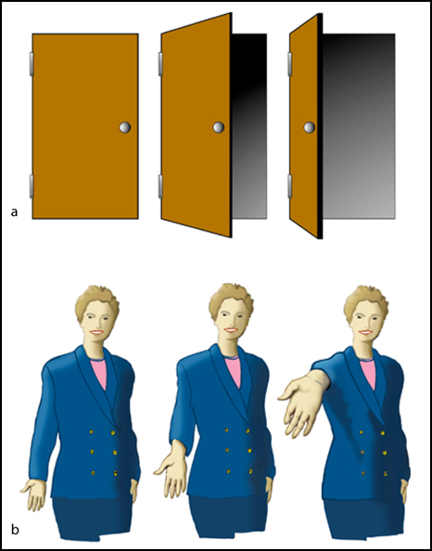
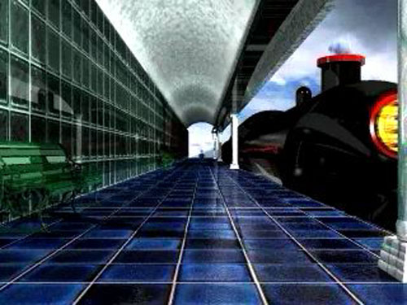
Size constancy
We perceive all three doors as rectangles and all three hands as equal in size.

Slide 26
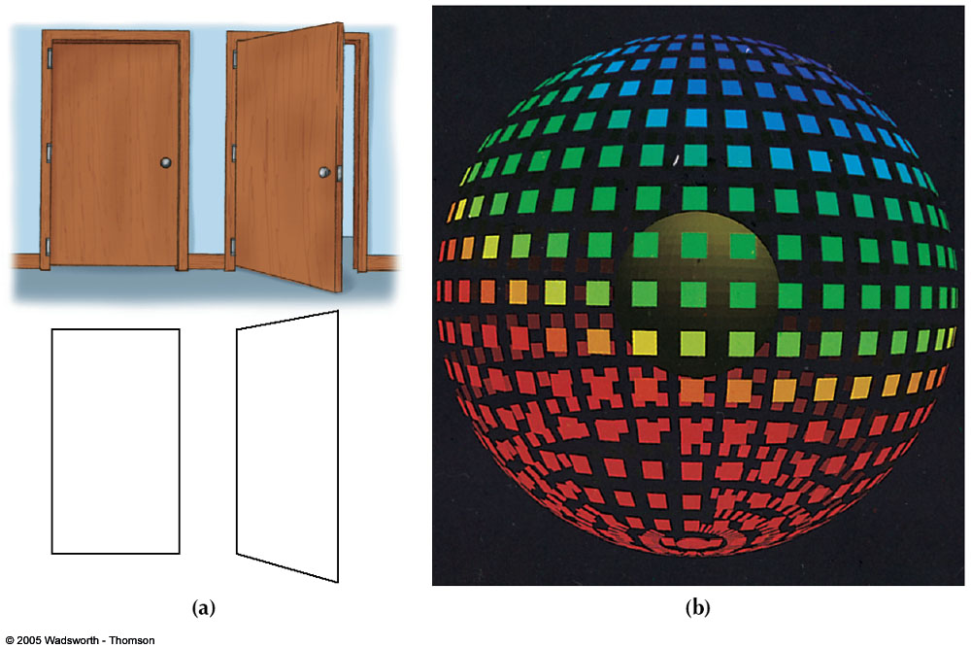
.
Shape constancy. (a) When a door is open, its image actually forms a trapezoid. Shape constancy is indicated by the fact that it is still perceived as a rectangle. (b)With great effort you may be able to see this design as a collection of flat shapes. However, if you maintain shape constancy, the distorted squares strongly suggest the surface of a sphere.

Slide 27
5.Perceptual Illusion
Illusions are misperceptions or false perceptions of an object, which include;
Visual or Optical illusions are physical stimuli that consistently produce errors in perception. E.g., Moon illusion and Muller-Lyer illusion on length of lines.
Visual or auditory hallucinations (sensory experiences and perceptions that do not corresponding to the reality).
Delusions are unfounded beliefs that are strongly held despite a lack of evidence for them. The three common types are;
A delusion of persecution is a belief that dangerous enemies are persecuting you.
A delusion of grandeur is a belief that you are unusually important, perhaps a special messenger from God or a person of central importance to the future of the world.
A delusion of reference is a tendency to interpret all sorts of messages as if they were meant for yourself.

Slide 28
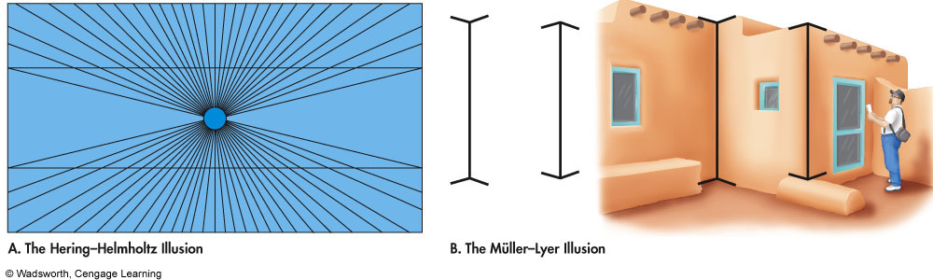

Slide 29
Extra Sensory Perception (ESP) or Paranormal Ability
ESP is perception that occurs independently of the known sensory processes. Usually included in this category of phenomena are;
Telepathy or thought transference between persons - The ability to read the minds of others & know what they’re thinking.
Clairvoyance - The ability to see events without being physically present. Supernormal awareness of objects or events not necessarily known to others; and
Precognition - The ability to see into the future.
Mediumship - The ability to communicate with spiritual world and talk to the deceased.
Clairgustance - The paranormal ability to taste a substance without putting it in mouth.

